Slide 1

Built in Data Types in C
Data Structure | Introduction to Data Structure
Course: Data Structure | Chapter: Introduction to Data Structure | Program: Bachelor of Engineering
DISCOVER · LEARN · EMPOWER
Notes:
Welcome students to the Chandigarh University Data Structure course. Today we begin our journey into the fundamental building blocks of programming. We will focus specifically on the built-in data types in C, which are the foundation for all complex structures you will build later. Remember, mastering these basics is essential for your success in this engineering program.

Slide 2
Course Outcomes
SLIDE 2 / 10
Course Outcome
CO | BT LEVEL | DESCRIPTION
CO1 | BT1 | Understand and apply basic data structures, algorithms, complexity analysis, ADTs, arrays and linked lists.
CO2 | BT2 | Apply and implement stacks and queues in problem-solving.
CO3 | BT3 | Analyse and apply searching, sorting, and hashing techniques.
CO4 | BT4 | Construct and apply tree structures and traversal techniques.
CO5 | BT5 | Represent and solve graph problems using DFS, BFS, and graph algorithms.
Chandigarh University
2 / 10
Notes:
This lecture directly supports Course Outcome 1, which requires you to understand and apply basic data structures. By mastering built-in types, you gain the necessary tools to implement arrays and linked lists effectively. These primitive types are the atoms from which all complex data structures are constructed in C programming.

Slide 3
Learning Objectives
SLIDE 3 / 10
Learning Outcomes
1
Define the concept of built-in data types in the C programming language.
2
Identify the four primary categories of primitive data types available in C.
3
Explain the storage size and range limits for integer and floating-point types.
4
Demonstrate the correct syntax for declaring variables using specific data types.
5
Differentiate between signed and unsigned integer representations in memory.
Chandigarh University
3 / 10
Notes:
By the end of this session, you will be able to define and identify the four primary categories of primitive data types. You will understand the specific storage sizes and range limits for integers and floating-point numbers. We will also practice declaring variables correctly and distinguishing between signed and unsigned representations. These skills are crucial for writing efficient and error-free C code.

Slide 4
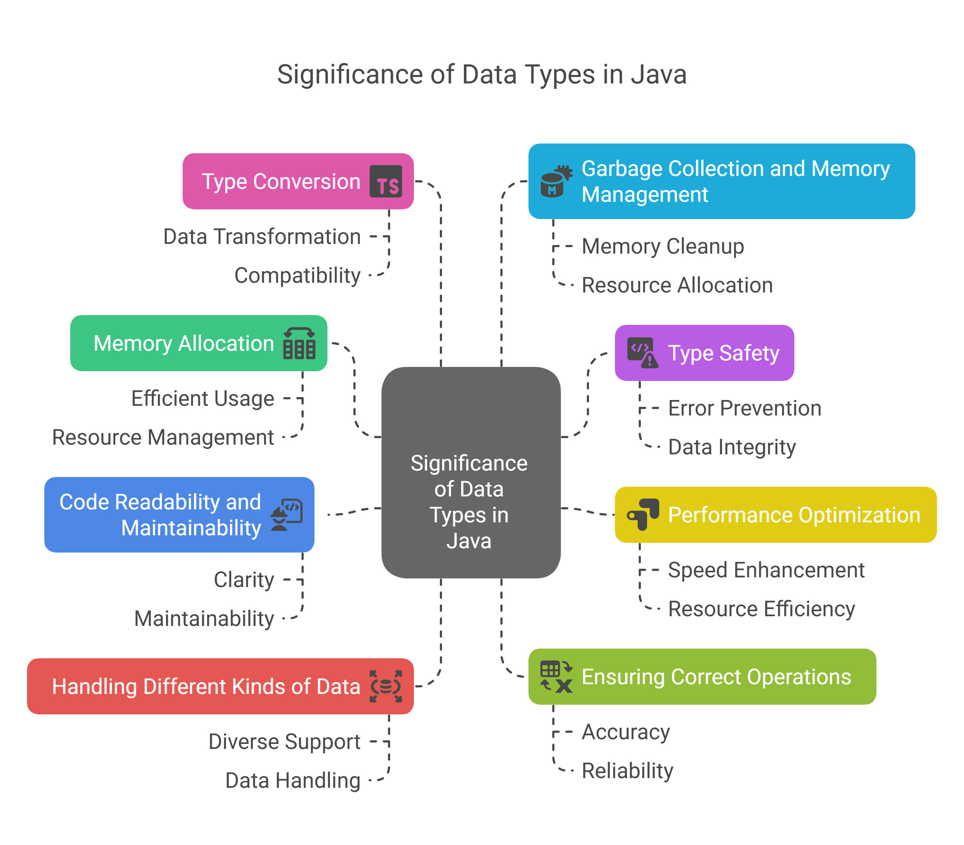
Lecture
SLIDE 4 / 10
Definition of Built-in Data Types
1
Built-in data types are predefined types provided by the C language compiler.
2
They represent basic values like integers, characters, and floating-point numbers.
3
These types are directly supported by the hardware architecture of the computer.
4
They form the foundation for constructing complex user-defined data structures later.
5
Using built-in types ensures portability across different C compilers and systems.
Data Types in Java – Your Quick Beginner's Guide
Chandigarh University
4 / 10
Notes:
Built-in data types are the fundamental building blocks provided directly by the C compiler. They represent basic values like integers and characters that map directly to the computer's hardware. Because they are supported by the hardware, they offer high performance and portability across different systems. Think of them as the raw materials, like bricks, that you will use to build complex structures later.

Slide 5
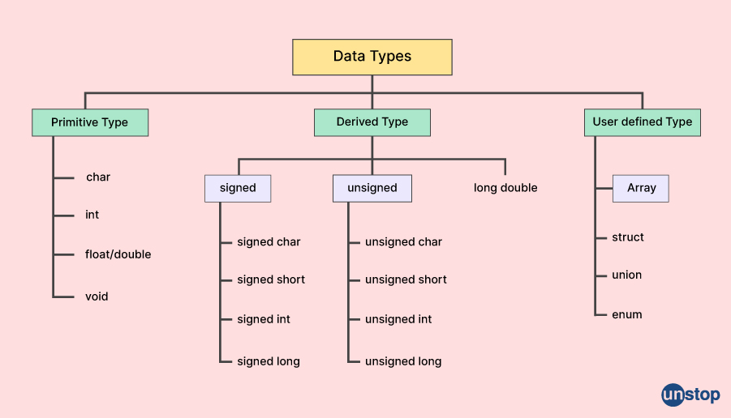
Lecture
SLIDE 5 / 10
Integer Data Types in C
1
The int type stores whole numbers without any fractional part.
2
The char type stores single characters using ASCII or Unicode encoding.
3
The short and long types modify the storage size and range of integers.
4
Signed integers include negative values while unsigned integers only store positive values.
5
The default size of int is typically 2 bytes or 4 bytes depending on the system.
Guide To Data Types In C (With Detailed Examples) (source: d8it4huxumps7.cloudfront.net)
Chandigarh University
5 / 10
Notes:
Integer types store whole numbers, while the char type handles single characters using ASCII encoding. You can modify the storage size using short for smaller ranges or long for larger ranges. It is critical to distinguish between signed integers, which include negatives, and unsigned integers, which only store positive values. For example, a standard int on most modern systems is 4 bytes, allowing a range from -2 billion to +2 billion.

Slide 6
Lecture
SLIDE 6 / 10
Floating Point Data Types
1
The float type stores single-precision floating-point numbers with approximately 7 digits.
2
The double type stores double-precision numbers with approximately 15 digits of precision.
3
The long double type provides extended precision for high-accuracy scientific calculations.
4
These types use the IEEE 754 standard for representing real numbers in memory.
5
They are essential for calculations involving fractions, scientific constants, and measurements.
Guide To Data Types In C (With Detailed Examples) (source: d8it4huxumps7.cloudfront.net)
Chandigarh University
6 / 10
Notes:
Floating-point types handle numbers with fractional parts, using the IEEE 754 standard for representation. The float type offers single precision with about 7 significant digits, while double offers double precision with 15 digits. For high-accuracy scientific work, the long double type provides even greater precision. For instance, calculating the value of π requires a double type to maintain sufficient accuracy for engineering applications.

Slide 7
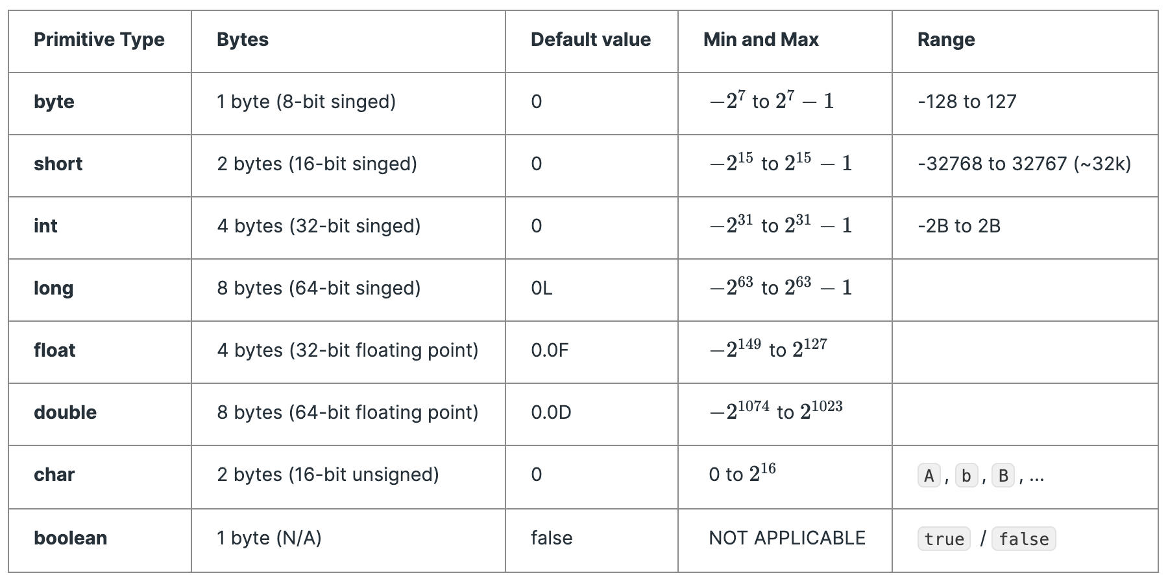
Lecture
SLIDE 7 / 10
Size and Range Examples
1
A char variable typically occupies 1 byte and stores values from -128 to 127.
2
A short int variable usually occupies 2 bytes with a range of -32,768 to 32,767.
3
A standard int variable typically occupies 4 bytes with a range of -2 billion to 2 billion.
4
A float variable occupies 4 bytes and stores values like 3.14159 with limited precision.
5
A double variable occupies 8 bytes and stores values like 3.141592653589793 accurately.
Source: storage.ghost.io
Chandigarh University
7 / 10
Notes:
Let's look at concrete examples of sizes and ranges. A char takes 1 byte, storing values from -128 to 127. A standard int takes 4 bytes, allowing a massive range from -2 billion to +2 billion. If you try to store the number 3.14159 in a float, you might lose some precision compared to a double. Understanding these limits prevents overflow errors when your program handles large numbers.

Slide 8
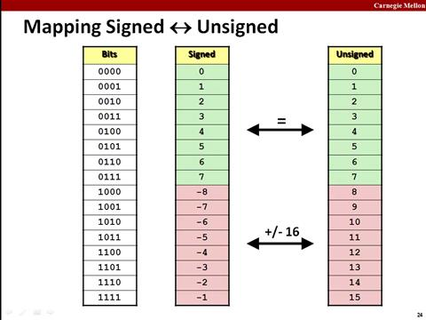
Lecture
SLIDE 8 / 10
Signed vs Unsigned Types
1
Signed types use the most significant bit to indicate positive or negative signs.
2
Unsigned types use all bits to represent magnitude, effectively doubling the positive range.
3
Attempting to store a negative value in an unsigned type causes undefined behavior.
4
Use unsigned types when you are certain values will never be negative.
5
Signed types are safer for general-purpose arithmetic involving subtraction or negative results.
Source: media2.dev.to
Chandigarh University
8 / 10
Notes:
The key difference lies in how the most significant bit is interpreted. Signed types use this bit for the sign, while unsigned types use it to extend the positive range. For example, an unsigned 16-bit integer can store values up to 65,535, whereas a signed one only goes to 32,767. However, storing a negative number in an unsigned variable leads to unpredictable results, so use signed types for general arithmetic.

Slide 9
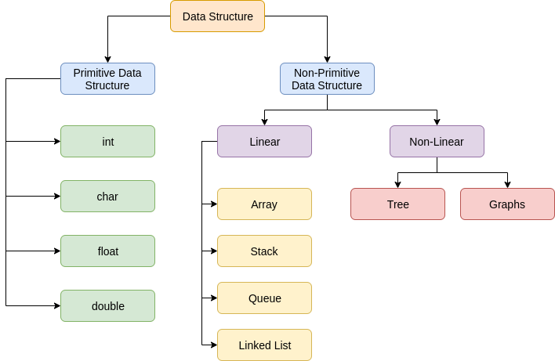
Lecture
SLIDE 9 / 10
Key Takeaways
1
Built-in types are predefined by C and map directly to hardware for efficiency.
2
Integers and characters form the basis for all complex data structures in C.
3
Floating-point types are essential for handling real numbers with fractional parts.
4
Understanding size and range limits is critical to prevent overflow and underflow errors.
5
Choosing between signed and unsigned types depends on whether negative values are needed.
Source: static.afteracademy.com
Chandigarh University
9 / 10
Notes:
To summarize, built-in types are the fundamental building blocks provided by the C language. Integers and characters are the basis for all complex structures, while floating-point types handle real numbers. Always be mindful of size and range limits to avoid critical errors in your programs. Finally, choose signed or unsigned types based on whether your data can be negative.

Slide 10
Lecture
SLIDE 10 / 10
References
DATA STRUCTURES
A Pseudocode Approach with C — Gilberg, Forouzan
• Data Structures — Lipschutz
• Data Structure Using C — AK Sharma
• C and Data structure — P. S. Deshpandey
Chandigarh University
10 / 10
Notes:
For further reading and deeper understanding, please refer to the standard textbooks listed here. Gilberg and Forouzan provide excellent pseudocode approaches, while Lipschutz offers a comprehensive theoretical foundation. AK Sharma's book is particularly useful for C-specific implementations, and Deshpandey provides a clear introduction to C and data structures. These resources will support your learning throughout the semester.

